Slide 1
FLS Unit 7
Johnny Vogt

Slide 2
Quick Questions
B
D
C
C, I think?

Slide 3
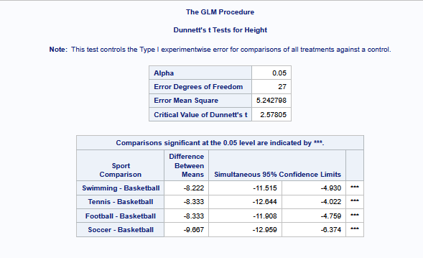
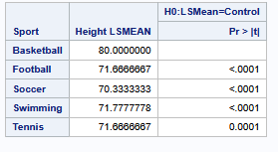
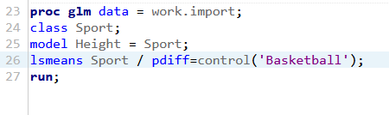
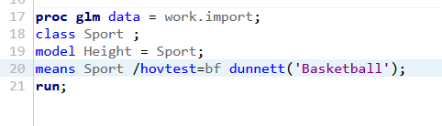
Basketball vs Everyone else (1 by 1)

Slide 4
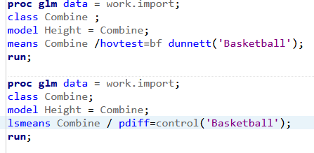
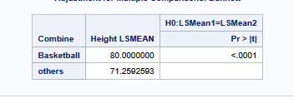
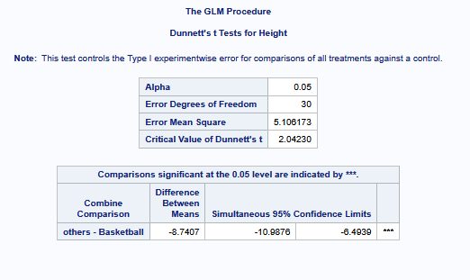
Basketball vs 1 group

Slide 5
Basketball vs the world (Average) Conclusion
We are 95% confident that the true difference in mean height between basketball players and players from other sports lies between 6.49 and 10.99 Inches. At a p-value of .001, the evidence suggests there the height of basketball players are substantially differ from the average of all the other sports combine.

Slide 6
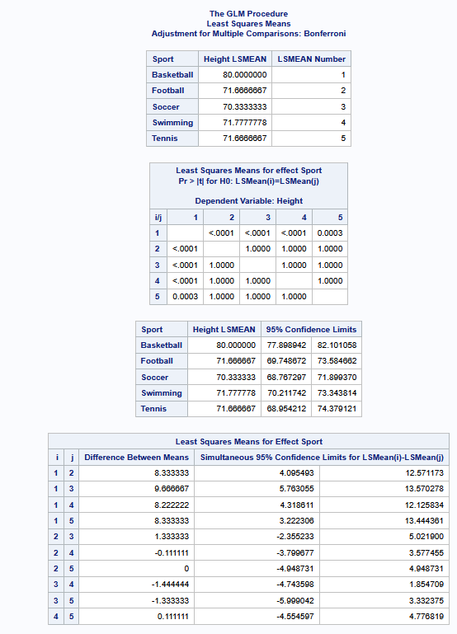
Let’s perform a Tukey’s
Or maybe a Bonferroni
And the same it agrees with the Extra Sum of Squares test . Basketball’s mean height is different from every other sport’s height. Even the Confidence Limits for the Basketball sport is above the range of every other sport’s Confidence limit.

Slide 7
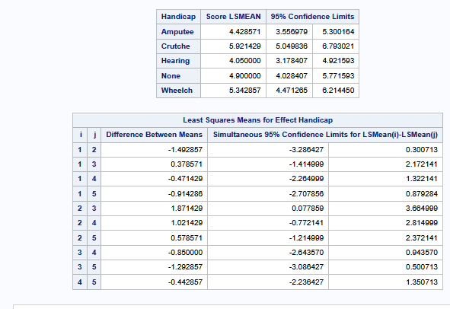
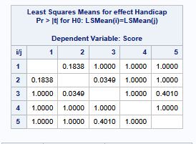

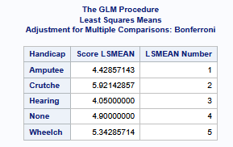
Bonferroni and the Handicap
Conclusion next page

Slide 8
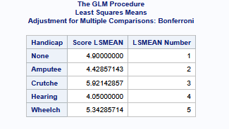
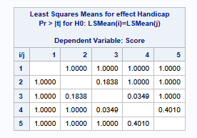
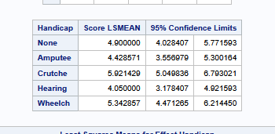
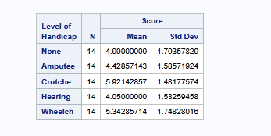
JK JK, Turns out “order = data” is very important

Slide 9
Bonferroni on Mobility type disability
There is not enough evidence to suggest that there are any difference between the means of Mobility groups. Since the difference between the means of Amputees, Crutches, and Wheelchair Scores have 0 within the range of the Confidence limits, none of the differences are significant enough to claim that there is a difference in means between mobility handicap interviewer.

Slide 10
Takeaways
I’m not sure how to explain most of the data in a conclusion.
I feel like some of the questions were vague in asking what it wanted us to do. I’m not sure I picked the right test in the middle one. I think Tukey was the right one, but I guess Bonferri is the more conservative approach? Is this what you mean by all models are wrong, some are just more helpful?
This week didn’t feel as difficult as last week, but still seems confusing.
Still feels like I”m missing some fundamental understanding on why we should we run this.

